Slide 1

SAPCAD ONBOARDING
SMART ARCHITECTURAL PLANNING WITH CAD AUTOMATION

Slide 2
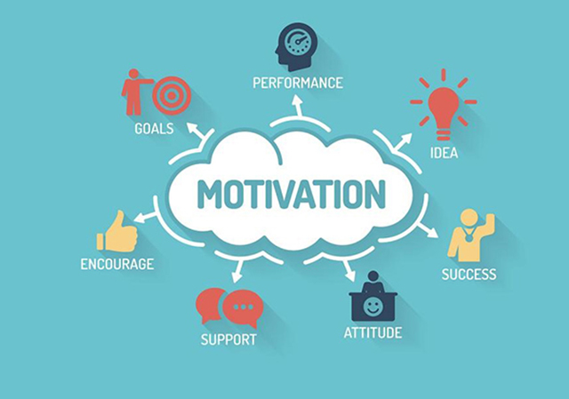
Motivation
Broader impact and relevance of the project
The Construction Industry’s Significant Contribution to Global CO2 Emissions
the construction of new buildings accounts for nearly 40% of global CO2 emissions and 60% of global waste
typical process of new construction (from production to completion) generates ~ 1/2 of the greenhouse gas emissions and energy consumption over a 50-year lifecycle
2) High Resource Consumption
responsible for 50% of Germany’s waste stream
other resources: earth, stone, wood, bamboo, concrete, and steel
3) One of the Least Digitized Industries
20% of all construction projects face delays in completion
in 80% of projects, the budget is exceeded

Slide 3
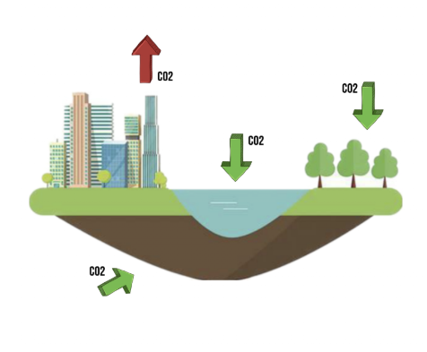
Motivation
Practical Applications and Benefits
CO2 Reduction – The optimization of architectural designs and material usage to lower CO2 emissions within the construction industry.
Resource Efficiency – Leveraging AI and 3D modeling to minimize waste and costs through optimized resource utilization.
Digitization of the Construction Industry – Advancing modernization through cutting-edge technologies that enable faster and more precise processes.
User-Friendliness – Intuitive operation via chatbot and web interface, accessible even to users without CAD expertise.

Slide 4
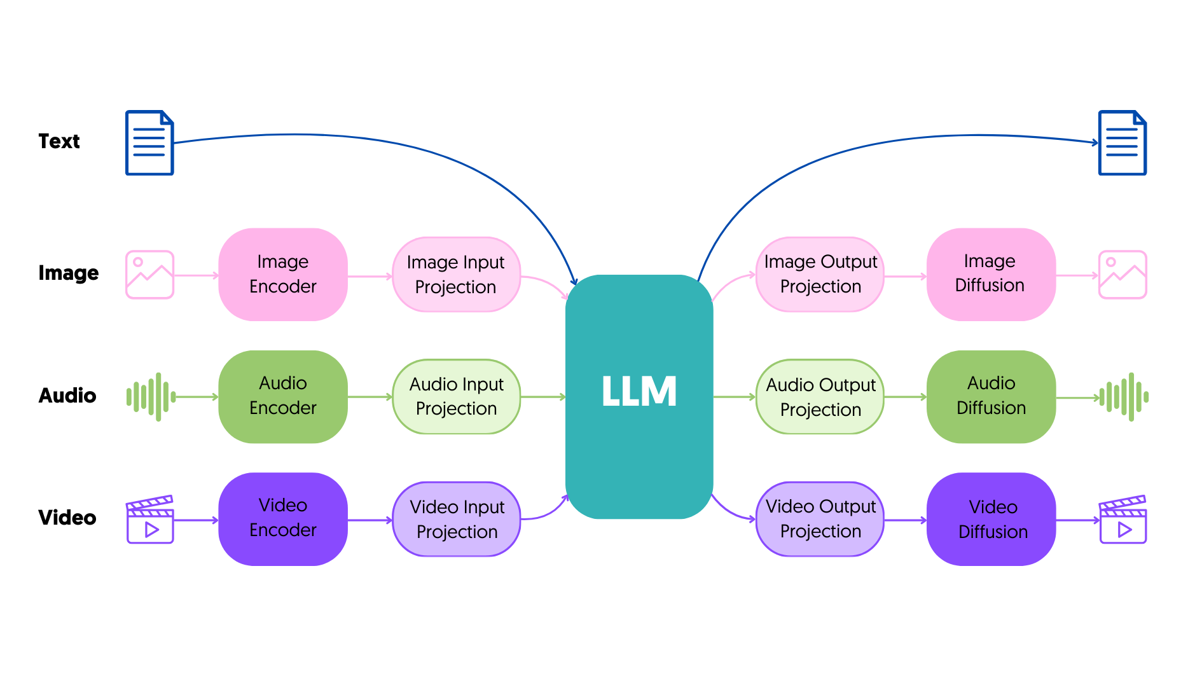
Vision
Deployment of a Multimodal (Speech, Image, 3D Models) AI Model
Multimodal AI = the next evolutionary step in artificial intelligence, enhancing the capabilities of models by processing multiple types of data to produce richer and more complex results
Multimodal AI systems consist of main components:
The Input Module – Utilizes unimodal neural networks (individual processing of different data types).
The Fusion Module – The core of the system, where these diverse data streams are combined and synchronized.
The Output Module – Generates the desired result from the merged data, which can be text, an image, or a combination of formats, depending on the original input.
https://dida.do/de/was-ist-multimodale-ki

Slide 5
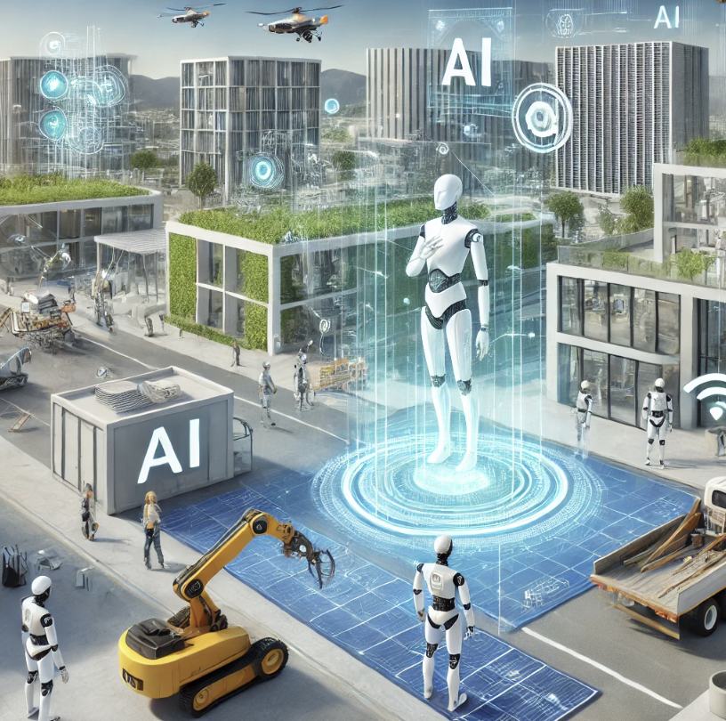
Vision
The Future of the Construction Industry – Sustainability and Innovation through Multimodal AI (Artificial Intelligence)
The transformation of the construction and architecture industries through the adoption of multimodal AI technologies (3D models, images, speech).
Promoting sustainability and efficiency by optimizing resource utilization and reducing CO2 emissions.
A long-term model for other industries in need of digitalization and resource optimization.
The democratization of AI technologies through user-friendly solutions that foster innovation and collaboration.

Slide 6
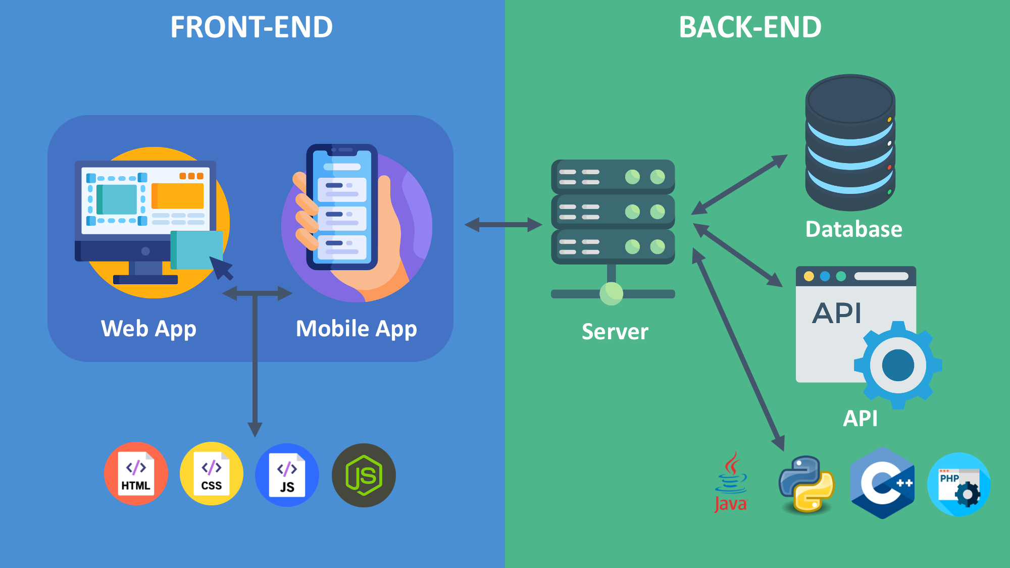
Objectives
Backend: Development of an AI-based prototype that adjusts architectural plans based on natural language
Frontend: Development of a website as a demonstrator

Slide 7
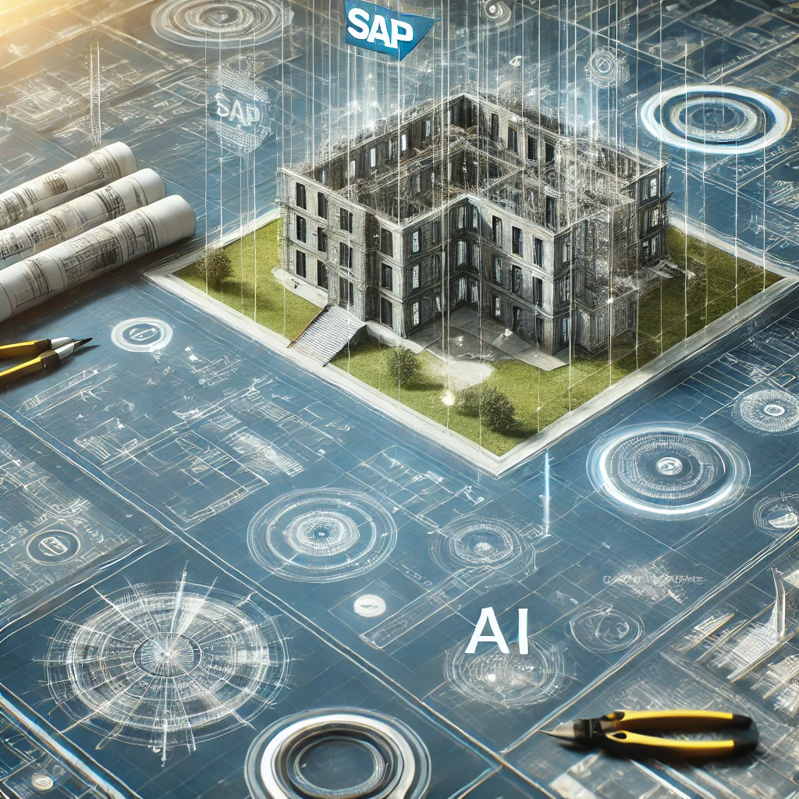
Expected outcomes and deliverables
Development of an AI prototype that adapts architectural plans into natural language
Creation of an application to demonstrate the AI model's functionality
Integration of a 3D visualization module for CAD updates
Evaluation of AI accuracy and efficiency compared to baseline models

Slide 8
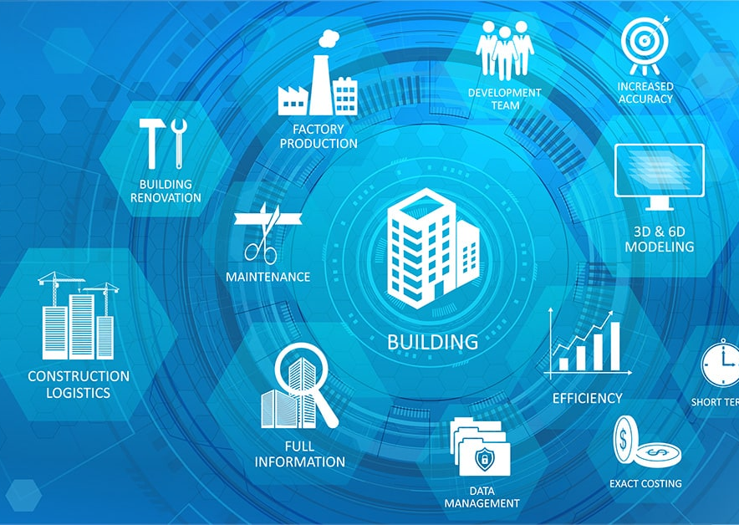
Introduction to BIM
Fundamental concepts of BIM
BIM = approach involving the generation and management of digital representations of the physical and functional characteristics of buildings or other physical assets and facilities.
Traditional building design was largely reliant upon 2D technical drawings. BIM extends the 3D (width, height and depth), incorporating information about time (4D BIM), cost (5D BIM), asset management, sustainability, etc. BIM therefore enables a wide range of collaborative processes relating to the built asset from initial planning through to construction.
The BIM concept envisages virtual construction of a facility prior to its actual physical construction, in order to reduce uncertainty, improve safety, work out problems, and simulate and analyze potential impacts.

Slide 9
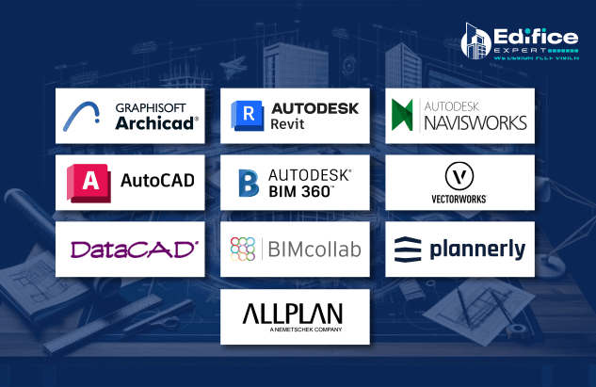
BIM Levels and software tools
Level 0 BIM: Paper-based drawings + zero collaboration
Level 1 BIM: 2D construction drawings + some 3D modeling
Level 2 BIM: Teams work in their own 3D models
Level 3 BIM: Teams work with a shared 3D model
Levels 4, 5, and 6 BIM: Adding in scheduling, cost, & sustainability information

Slide 10
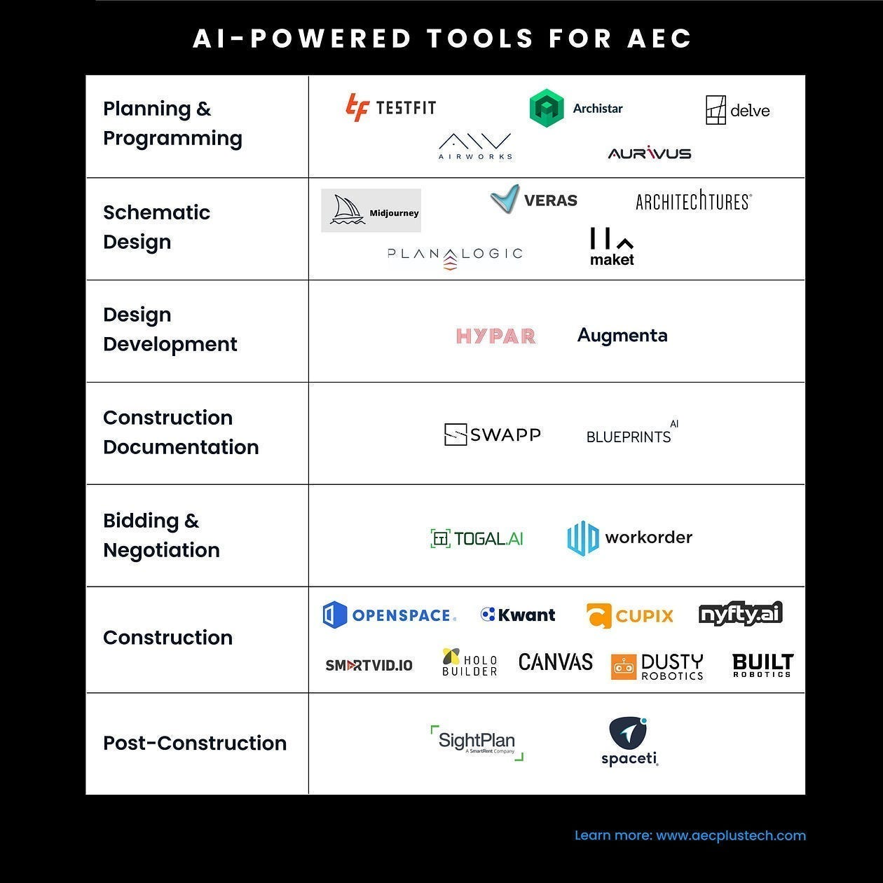
Significance of AI in AEC (architecture, engineering, and construction)
Efficiency: Automates design processes, reducing time and human error
Sustainability: Optimizes material use and energy efficiency
Compliance: Ensures designs meet regulations and standards
Visualization: Enhances 3D modeling for better project planning

Slide 11
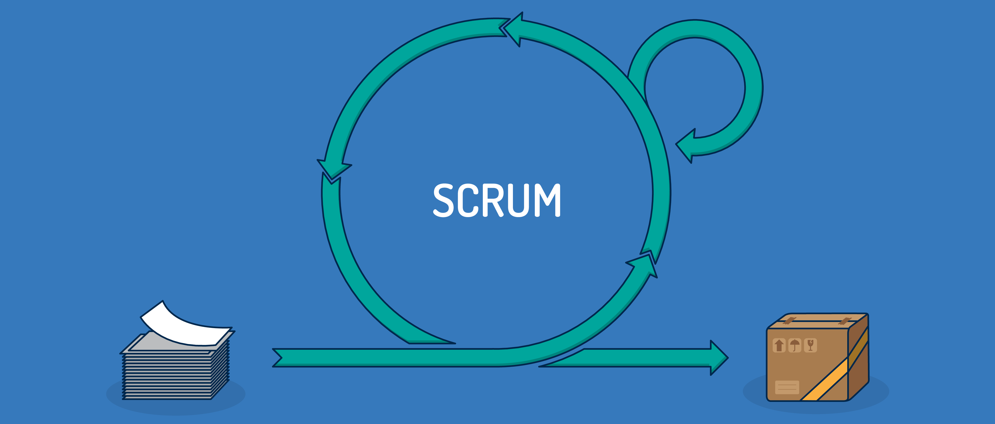

Scrum – the Agile software development framework
Traditional software development processes operate linearly—planning first, then development, then testing, and so on. Agile software development, on the other hand, takes an iterative approach. Projects are broken into short stretches of time called sprints.
With each sprint, the development team adds and improves features to gradually deliver the best product possible. Testing and development happen frequently and often overlap.

Slide 12
Scrum - Principles
Scrum
1.Control over empirical processes
2.Self organization
3.Collaboration
4.Value-based prioritization
5.Time-boxing
6.Iterative development
https://lucidspark.com/blog/introduction-to-scrum

Slide 13
Scrum Teams
Team
Product Owner
Development team
Scrum Master
Customer & dev. team
link
1 role
Allocating time & resources
Coders & Designers
Small team
Meetings
coordinates
plans

Slide 14
